Slide 1


Friday Forum TechWatch:
Connected Vehicle Introduction
Host: Vajira Weerasekera
Guest Speakers: David Peterson, Akihito Hayashi
Friday February 10, Singapore time 11AM

Slide 2


Introducing our speakers
David Peterson
Chief Architect
CDSA
16 Years @ Microsoft – All in Microsoft Services in Canada
Services CTO Microsoft Canada for 3 years before joining CDSA
Live in Toronto with my wife and step-daughter.
Travel and food – my 2 favourite things!
Akihito Hayashi
Architect
CDSA(Asia)
3 months @ Microsoft Service Japan
13yrs @ multinational electricity company in JP and SG
IoT experience w/ home and industory A/C, Storage Battery etc
Tennis, Road bike etc …

Slide 3
Microsoft Connected Vehicle Platform
Notes:
30 secs

Slide 4
Challenges facing the industry
Notes:
5s

Slide 5
The automotive industry is at a transformational moment
The industry is being transformed by a combination of key technology and business model trends
As a result, automakers need to:
By 2030…
1
Connected
~100% of new cars projected to be
connected, up from ~25% today
Transform into mobility service providers
2
Shared
~32% of miles driven on new cars
will be in shared rides
Invest in vehicle sharing and fleet management services
3
Autonomous
~10-15% of new cars projected to
be fully autonomous
Own AV technology
4
Electric
> double the # of EVs by,
better charging infrastructure
Embrace customer demand
Notes:
1 min
Why is digital disruption happening now?
The convergence of technological advances
Growing customer demand

Slide 6
Primary Drivers & Motivations For Automotive
OEMs are being pushed to adapt and evolve by technology…
Motivators
Technological convergence
Expand business opportunities
Improve driving experience
Growing consumer demand
Retain customer connection
Notes:
Why is digital disruption happening now?
The convergence of technological advances
Growing customer demand

Slide 7
Challenges facing OEMs
Cost
Scale
Complexity
Agility
Security
Notes:
Speed/time to market/agility

Slide 8
To build connected cars, OEMs, suppliers and partners need…
Global Scale & Reliability
Flexibility & Openness
Security & Compliance
…in a solution that provides data sovereignty, data privacy, and full control
Sources: McKinsey; Accenture; Corp Strat analysis
Notes:
Cost, complexity, scale and security are the key challenges

Slide 9


Automotive services require technology partnership
Microsoft can support the connected car industry transformation by enabling rich, data-based services.
~25 GB of data created by connected cars each hour*
Scalable intelligent cloud service to aggregate and analyze data and the productive platform to extend consumers digital life into the car
Vehicle Sensors
AV tech sensors, sensor fusion
Telemetry
Scalable Data Ingestion & Storage
Data Protection & Compliance
Driver Data
Driving behavior
Location
Infotainment
Machine Learning & Analytics
Mapping & Location
External Data
V2V/V2I/V2X communication
Weather Data
1
0
1
0
Search + Enterprise Graph
1
0
1
0
0
1
1
1
*Not all data will be transmitted to the cloud
Office 365
Cortana
Skype

Slide 10
Microsoft Connected Vehicle Platform

Slide 11
Introducing the Microsoft Connected Vehicle Platform
Microsoft Connected Vehicle Platform consists of a set of services, that enable automotive OEMs and Tier One suppliers to build global scalable connected vehicle solutions, deliver unique experiences for their customers and digitally transform their businesses.

Slide 12
Microsoft Connected Vehicle Platform
PURPOSE BUILT
Customized instances of the platform. Microsoft can customize and operate.
Managed Services
Managed Services
Managed Services
OEM Specific Customization of Connected Vehicle Solution
OEM Specific Customization of Connected Vehicle Solution
OEM Specific Customization of Connected Vehicle Solution
MICROSOFT CONNECTED VEHICLE PLATFORM
Spanning in-car and cloud. These pillars support common use cases for connected car.
Telematics and Predictive Services
Productivity and Digital Life
Connected Advanced Driver Assistance Systems
Advanced Navigation
Customer Insights and Engagement
COMMON SERVICES
Azure PaaS Services + Microsoft Productivity Suite
Azure IoT Suite
Machine Learning
& Analytics
Artificial Intelligence
Mapping & Location
Microsoft Graph
Skype
Cortana personal assistant
Office 365
Additional Azure Services
Storage | Compute | Networking | Etc.

Slide 13
Purpose Built for Automakers Individually
Automakers will leverage Microsoft Services or approved System Integrators to customize, augment and operate the solution.

Slide 14

Our approach
Platform approach
We are here to partner
80% solution, gives you flexibility to customize to your specific needs
Approach is to leverage the automotive ecosystem
Sources: McKinsey; Accenture; Corp Strat analysis

Slide 15
Connected Vehicle Reference Architecture
CDSA
Modern Apps
Extensions \ 3rd Party Integrations \ OEM Systems
Service Management
Modern Apps
Apps
App
App
App
App
App
App
Service Provider Proxy
Modern Apps
Data Insights
Cloud Services
Data
Data Lakes / Storage / Big Data / ML
Content Management
APIs
Exposes connected car functionality to external applications
Secure Infrastructure
Cloud-to-Cloud Interfaces
Device Management
Third Party / Legacy
Vehicle Command Processor
Micro-services for specific functions
Generic Interface
Interface for all clouds to connect
Device Management
Vehicle Lifecycle Management
Secure Infrastructure
Vehicle Hub
Provides vehicle connectivity, messaging, & device management
MNO Interface
Specific interface for MNO integration
MNO
Custom SIM Management
SMS
Carrier Level Wake Up
Jasper
Modern Apps
Protocol Gateway
Erickson
Notification Management
Secure Infrastructure
Azure
Vehicle
MQTT
CAN Bus
Car
Infotainment/Head Unit
Telematics Control Unit
ECU
ECU
ECU
ECU

Slide 16
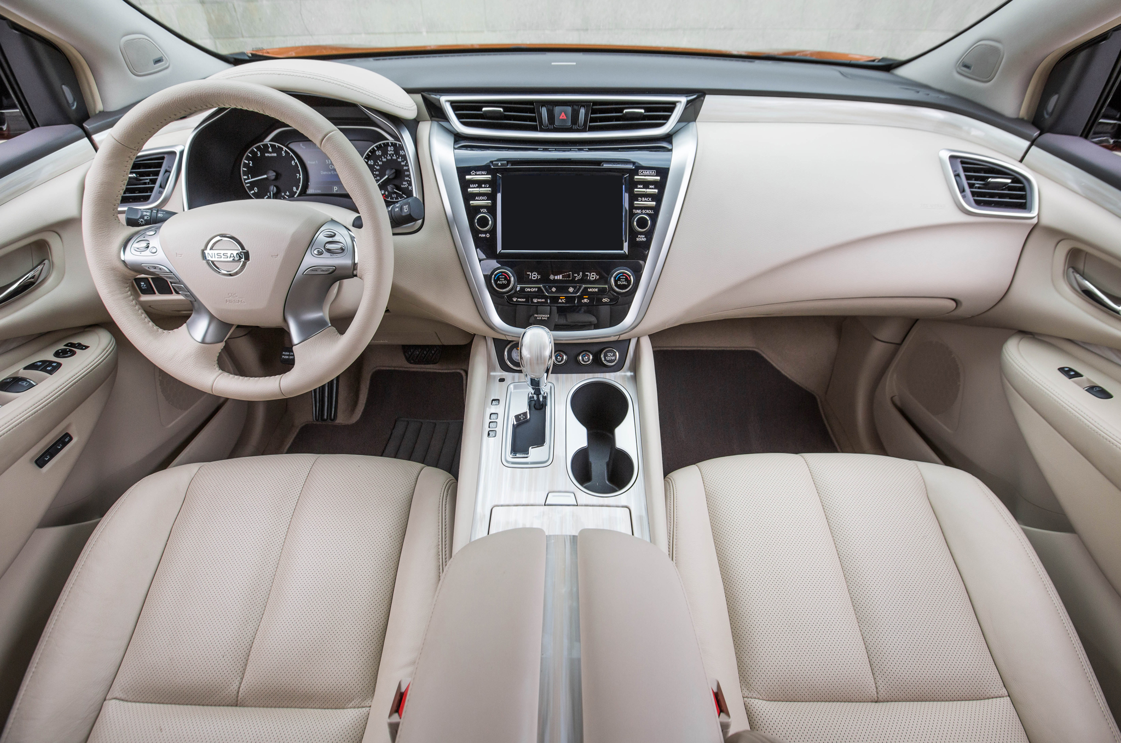


&
Notes:
Bulent

Slide 17
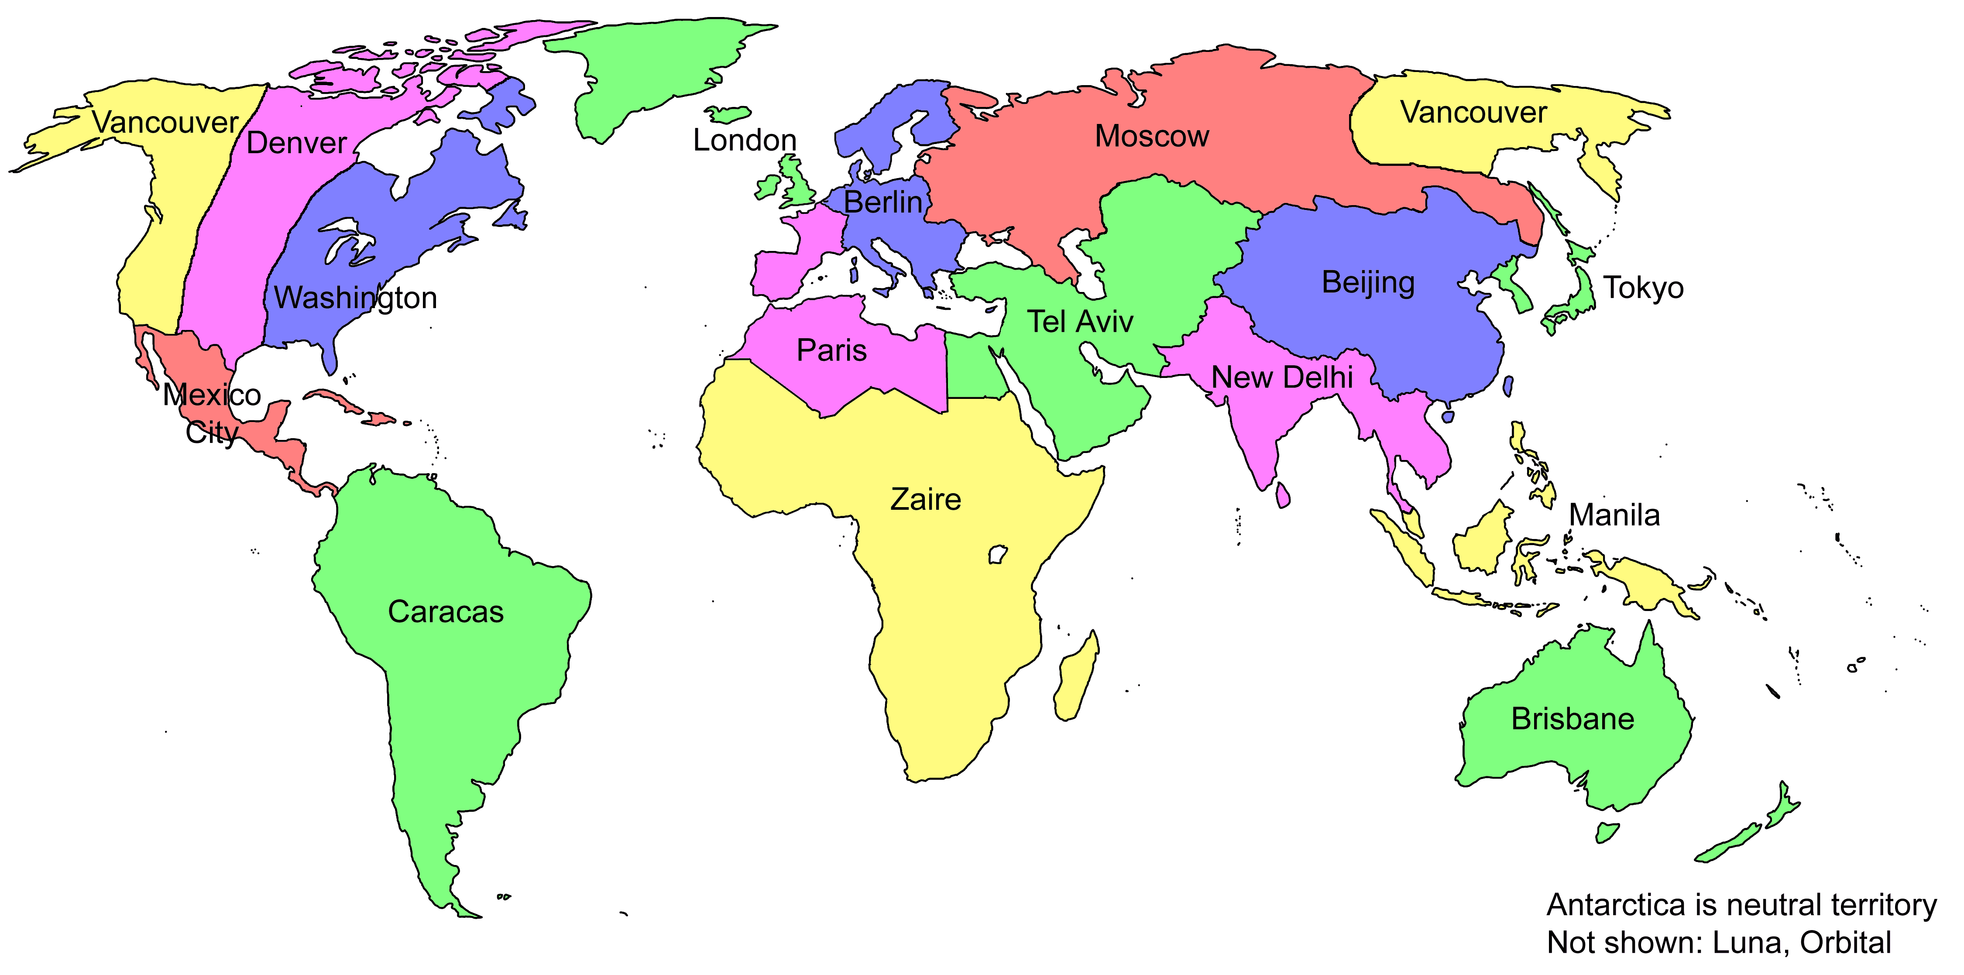
AvNext: Microsoft provides next generation Connected Car platform to Renault-Nissan Alliance
An automotive platform providing automotive services to the Alliance and its partners. The solution architecture is decomposed in two main sub-systems:
Core Features (CVP)
Contains the «low-level» building blocks of the solution. Exposes features which are common across a set of services.
Services Layer
Independent services built as a composition of core features + additional business logic is consumed by Alliance regional systems and Commerce systems
Services Layer
Service 1
Service 2
Service 3
Service N
Services Management
API Management
Core Features
Device Gateway
Data Management
Device Management
M2M / Proxy
Project Team Locations
USA
France
India
Japan
China
Build Phase = 80 resources over 18 months
Run Phase = Azure + Managed Services
Notes:
Bulent
5 min

Slide 18
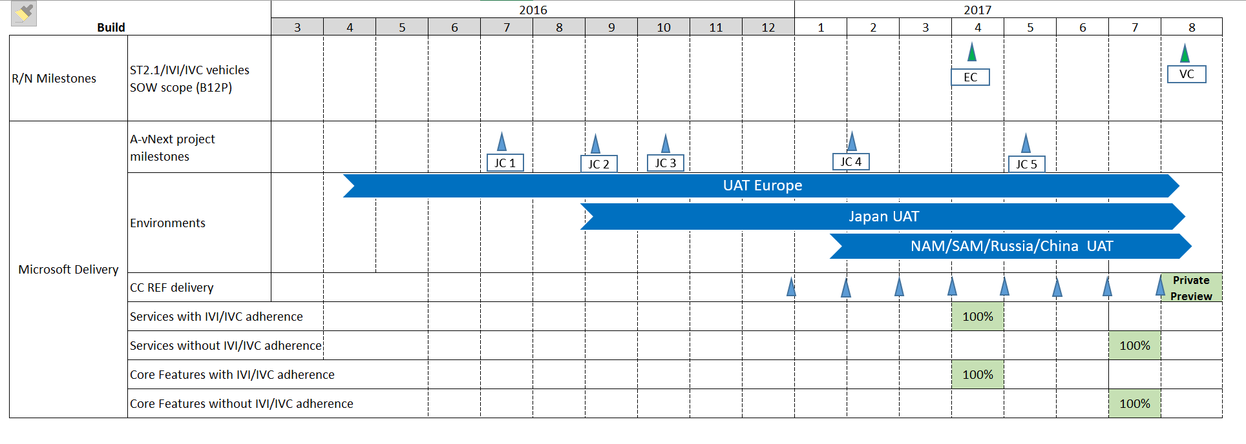
Current Status
Today
Notes:
Bulent
5 min

Slide 19
95 Car Services Into Various Categorizations
Always More Control
Remote Charging Control
Remote Vehicle Settings
Remote Profile Management
Remote pre-conditioning
Remote lock/unlock
Remote Horn & Lights
Pro-active Monitoring
Remote Car Dashboard
Charging Dashboard
Fleet Asset Management
Fleet Activity Management
Stolen Vehicle Tracking
Theft Burglar notification
Geo-fencing
Smarter & Pro-active Moves
Traffic Information
Advanced Navigation Enriched Content
Advanced Navigation Engine predictive calculation
Road Alert
Location-based information
End-to-end navigation
Online automatic payment
Sharing & Interacting
Cloud Car Sharing
Community Dashboard
Lend my car (remote lock/unlock)
Integration with my digital life
Online Content
Communication Application
Connected Assistance
Concierge Call
On-board message
Emergency call
Helpdesk call
Assistance call or breakdown call with diag
Automatic collision notification
Tailored-fit services
Digital Dealer
Customer Profile
Data for PAYD / PHYD
Remote Vehicle diagnostics
Data for external use
Update over the air
Notes:
Simon
5 minutes
What makes up a connected vehicle?
This is a business view

Slide 20
Lessons Learned
Patterns are key to enabling services
Onboard software/hardware implementation process extremely non-agile
Balancing next-gen architecture with legacy systems
Given millions of cars, every technical choice impacts resources and cost
Aligning deliverables timeline to engineering schedule is often non-trivial
Notes:
Bulent
15 / 20 min

Slide 21


Global Project Delivery – Diverse Cultures
America
Canada
France
India
China
Japan
Notes:
Andrew
5 min
The AvNext project has an Architect team that spans the globe! How does that work in practice?
How many architects do you think the AvNext team has? (Answer: 5 – David, Amit, Simon, Akihito, Bulent)
12 total architecture team members
Challenges with multi-timezone / language

Slide 22
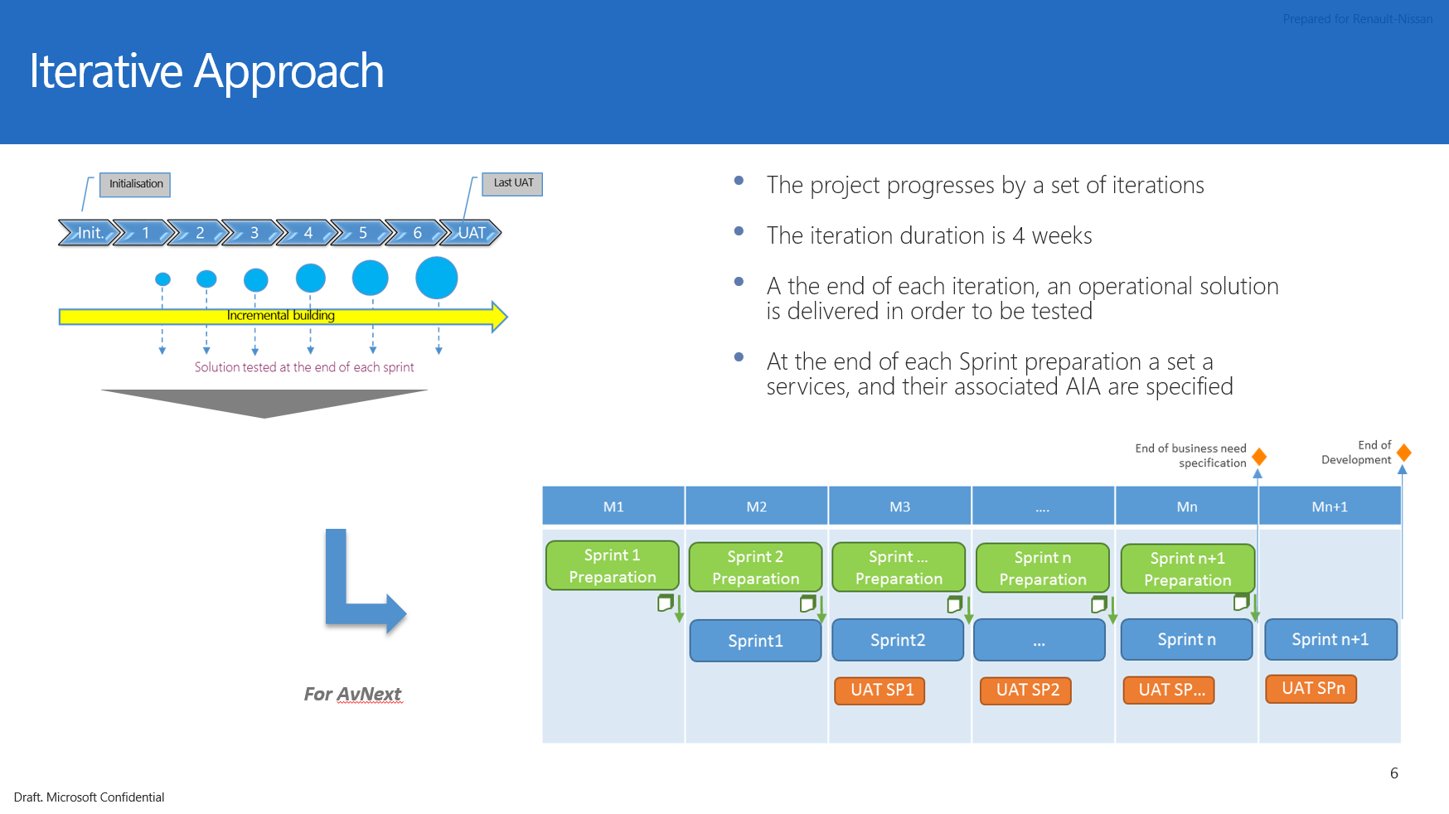
Renault / Nissan – Sprint Process
Notes:
Andrew
5 min

Slide 23


Thank YOU
Copyright © 2016

Slide 25
Why partner with Microsoft?

Slide 26
Why partner with Microsoft?
Built on Microsoft technology
Microsoft has been enabling digital transformation in various industries, including the automotive sector.
Built on a global, scalable, open and secure platform.
Expertise in hyper-scale cloud, IoT, Machine Learning and Artificial intelligence.
Microsoft can do the heavy lifting on the back end, while you focus on delivering what matters most: innovative customer-facing experiences.
We don’t compete with you, we partner with you.
38
Azure regions worldwide
$15B
Invested in cloud
200+
Azure cloud services available
Notes:
Flexibility and control - Using our platform as a starting point, auto firms can work with systems integrators to build custom solutions tailored to their goals.
Openness - the platform gives firms the freedom to use whatever services, components, and capabilities are best for them
Support for ongoing technology evolution
Global consistency
Trusted partnership

Slide 27

Ecosystem
Extensibility for third-party integration
Integration with internal systems
Enable additional services and business models
Tier-one and other downstream suppliers and SI’s are critical to bringing connected cars to market
Suppliers
System integrators (SI’s) and consulting services.
ISVs / Software Providers.
A broader ecosystem expands the services connected cars deliver
Sources: McKinsey; Accenture; Corp Strat analysis

Slide 28

Benefits for automakers
Save money on updates, warranty issues, and recalls.
Promote Safety
Increase customer engagement and offer tailored experiences.
Improve sales and marketing efforts.
Develop new business models and scenarios.
Transform the broader enterprise to optimize current and future products.
Sources: McKinsey; Accenture; Corp Strat analysis

Slide 29
Telematics & Predictive Services
Use insights from vehicle data to prevent downtime, warranty and recall issues, and offer new services that improve user experience
OTA Updates, Predictive Maintenance, V2X
Telemetry
D2C messages
Telecommand
C2D messages
Device Management
FOTA / SOTA
Predictive Maintenance
Vehicle Health Report
Find My Car
Remote Lock/Unlock
Remote Precondition
Sample scenario: The vehicle collects battery usage data over time and sends it to the cloud. Machine learning analysis determines that the battery has a 70% likelihood of failure in the next 3 months. A timely predictive service recommendation is generated and sent to the user through their smartphone and in-car infotainment system, helping prevent the user from suffering through a dead battery, especially in the dead of winter.

Slide 30
Productivity & Digital Life
Help customers do more while reducing driver distraction and safety hazards
Microsoft Office 365, Cortana Personal Assistant, Skype, Bing
Sample scenario: A driver is getting ready to leave for work. First on the agenda is a morning conference call that will start while the driver is en-route. During the trip, Cortana asks the driver if they want to join the call. The driver responds “Yes, thanks Cortana” and joins the call automatically, without having to dial a code or enter conference information. The call audio is played over the car speakers. During the call, some important emails come in, and the driver mutes their microphone and listens to them using voice command. During the drive, the vehicle sees via Office 365 integration that the next meeting location has changed and automatically suggests a new route..
Voice Personal Assistant
Cortana in the car & out of the car
Calendar
Office 365
Communications
Office 365 Email, Skype Conferencing
Task Management
Outlook / Office 365

Slide 31
Connected ADAS*
Increase safety, optimize vehicle performance, & deliver real-time information to the driver or autonomous system
Deep Learning Neural Network for batch training
In-car trained model for real-time evaluation
Ongoing capture and retraining
Capture, analyze and act on live road conditions
Sample scenario: A stray piece of debris is blocking a lane of traffic one mile ahead. Data from connected ADAS from the surrounding cars recognizes the debris and communicates that information to approaching cars, helping them proactively adjust to the slowdown well in advance.
* ADAS – Advanced Driver Assistance Systems

Slide 32
Advanced Navigation
Unify navigation data elements like maps, weather, traffic, and parking to deliver optimized routing and location based services
Highly Automated Driving Maps, Geolocation & Geofencing
Geolocation & geofencing
Contextual POI search
Contextual routing
Geospatial Analysis
Maps for Highly Automated Driving (HAD)
Sample scenario: A car knows that its driver leaves for work at 7:55am every day. It detects that the driver has an 8:00am meeting, and selects and suggests a different route based on optimal cell connectivity for the Skype call, rather than the shortest trip duration.

Slide 33
Customer Insights & Engagement
Connect across the entirety of a customer’s digital life through custom applications, CRM integration, and new business models
Microsoft Dynamics 365 CRM, Driver Profiles, Omni-channel
Mobile solutions
CRM integration
Analytics & insight Discovery & shopping tools
Sample scenario: Having opted into an OEM loyalty program powered by Dynamics 365, a driver’s car can proactively provide special offers based on insights that he visits a restaurant in a busy part of town frequently. The OEMs CRM system suggests a parking services application that can automatically reserve a parking spot near the destination, and delivers a discount coupon for a new item at that restaurant.
Sources: McKinsey; Accenture; Corp Strat analysis

Slide 34
Conceptual Architecture
Services Layer
Service 1
Service 2
Service 3
Service N
Services Management
API Management
Core Features
Device Gateway
Data Management
Device Management
M2M / Proxy
Notes:
Simon
5 min
CVP provides the foundation for many services for V1
Core Features are things that need to be implemented by MS, but could be added to CVP later

